Slide 1
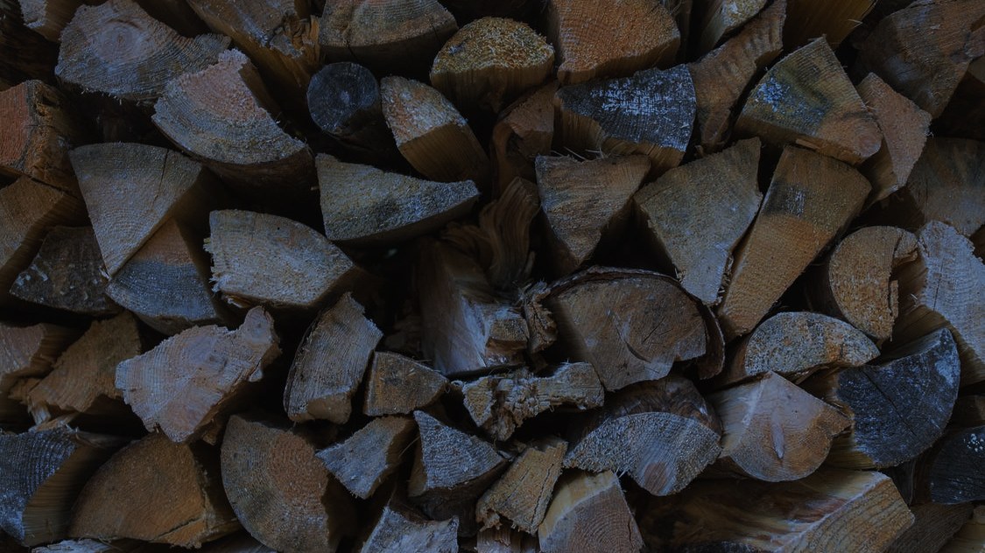
PRESENTATION TEMPLATE
NAMES OF PARTICIPANTS

Slide 2
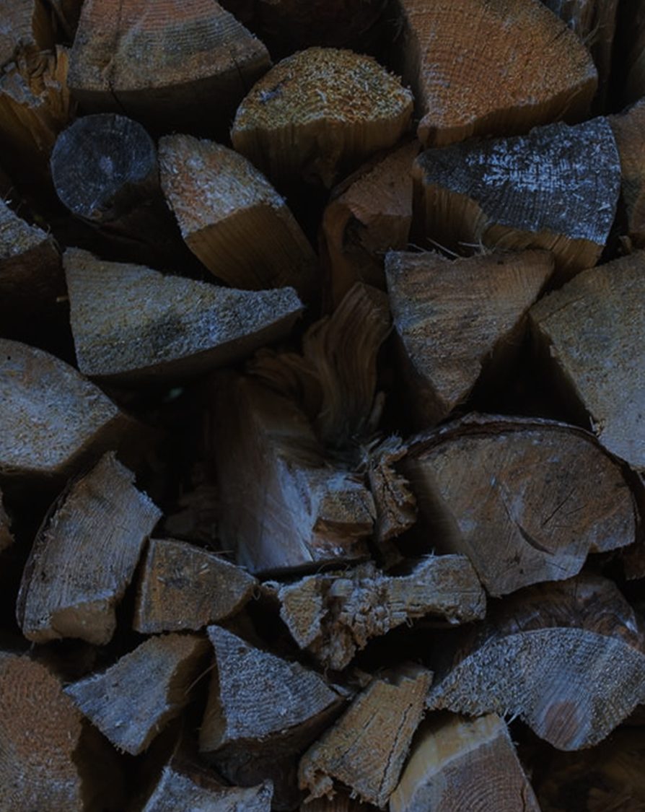
PRESENTATION TEMPLATE
NAMES OF PARTICIPANTS

Slide 3
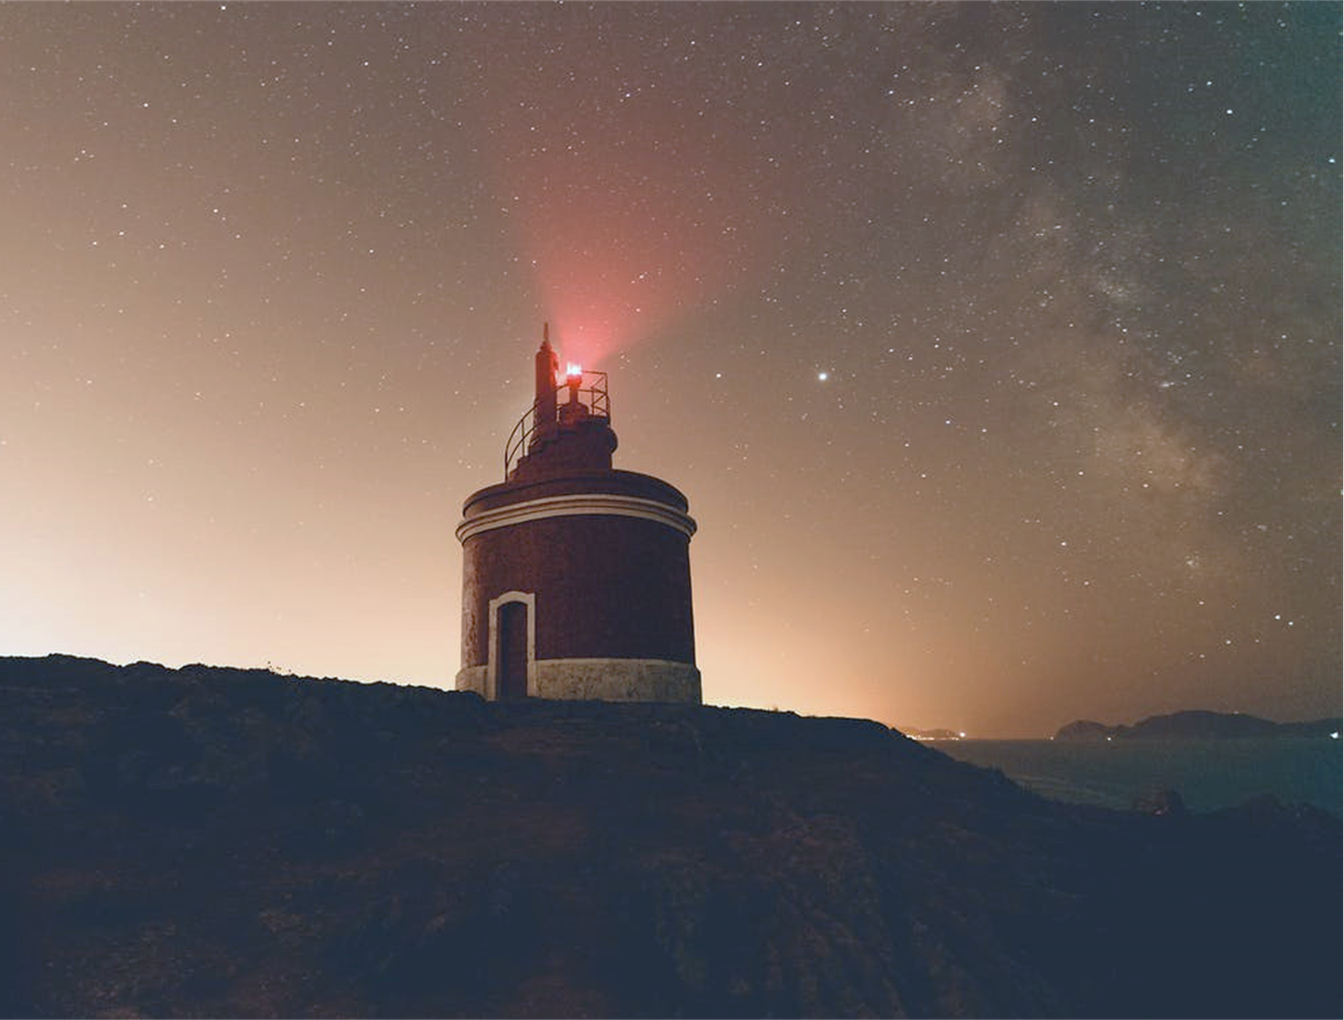
PRESENTATION TEMPLATE
NAMES OF PARTICIPANTS

Slide 4


PRESENTATION TEMPLATE
NAMES OF PARTICIPANTS

Slide 5

SLIDE HEADLINE
Use this device to create promising paintings already in the Middle Ages, and among artists of the Renaissance
Use this device to create looking pictures

Slide 6


Use this device to create promising paintings already in the Middle Ages, and among artists of the Renaissance Use this device to create looking pictures
SLIDE HEADLINE

Slide 7

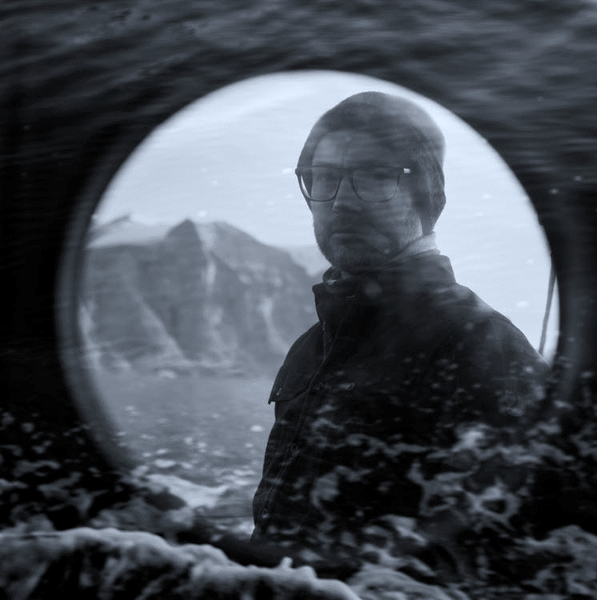

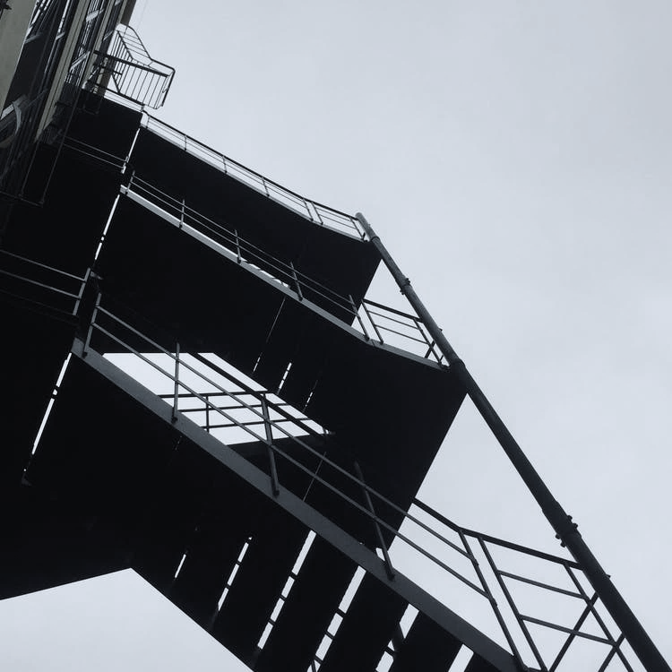
IT IS ALSO NECESSARY TO PROVIDE FOR
It is also necessary to provide for
the reliability of the results
CORRECT THEM
Interpretation

Slide 8
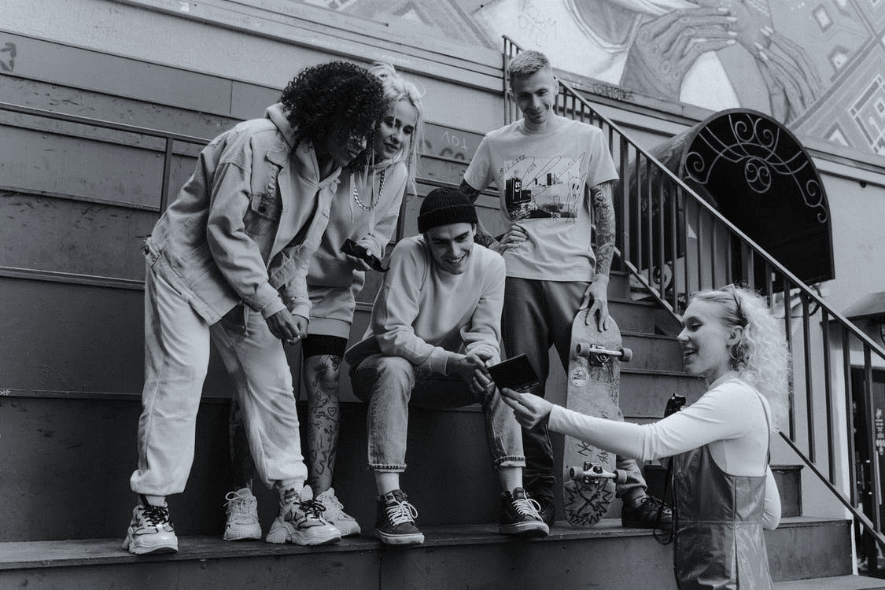
SLIDE HEADLINE
Use this device to create promising paintings already in the Middle Ages, and among artists of the Renaissance Use this device to create looking pictures

Slide 9

SLIDE HEADLINE
Use this device to create promising paintings already in the Middle Ages, and among artists of the Renaissance
Use this device to create looking pictures

Slide 10
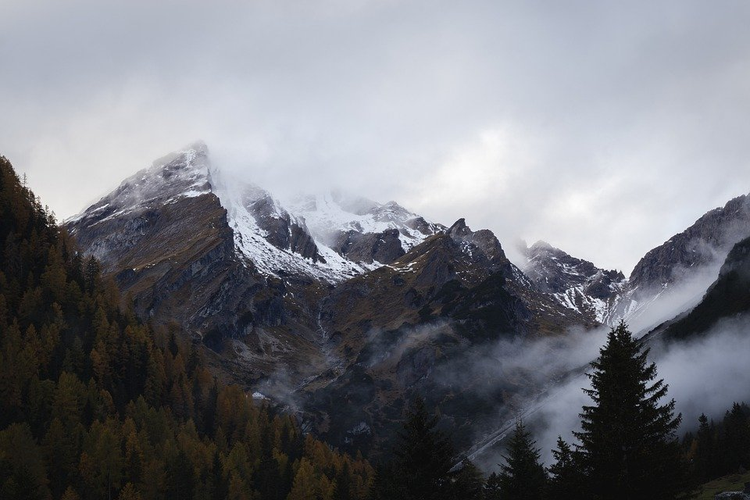
SLIDE HEADLINE
Use this device to create promising paintings already in the Middle Ages, and among artists of the Renaissance
Use this device to create looking pictures

Slide 11
SLIDE HEADLINE
Use this device to create promising paintings already in the Middle Ages, and among artists of the Renaissance
Use this device to create looking pictures

Slide 12

SLIDE HEADLINE
Use this device to create promising paintings already in the Middle Ages, and among artists of the Renaissance
Use this device to create looking pictures

Slide 13





SLIDE HEADLINE
Selecting the right number of experimental sites
Selecting the right number of experimental sites
Selecting the right number of experimental sites
Selecting the right number of experimental sites

Slide 14


The researcher needs to observe certain logic and steps when organizing the experiment. Basically, they allocate 4 to 6 stages, which reflect the logic of the experimental study.

Slide 15




SLIDE HEADLINE
The researcher needs to observe certain logic and steps when organizing the experiment. Basically, they allocate 4 to 6 stages, which reflect the logic of the experimental study.
Selecting the right number of experimental sites
Selecting the right number of experimental sites
Selecting the right number of experimental sites

Slide 16
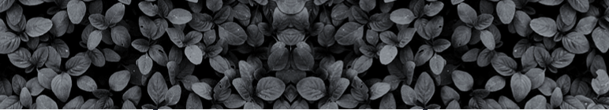
SLIDE HEADLINE
The researcher needs to observe certain logic and steps when organizing the experiment. Basically, they allocate 4 to 6 stages, which reflect the logic of the experimental study.

Slide 17





Header
The program can be fleshed out by the plan
Header
The program can be fleshed out by the plan
Header
The program can be fleshed out by the plan

Slide 18
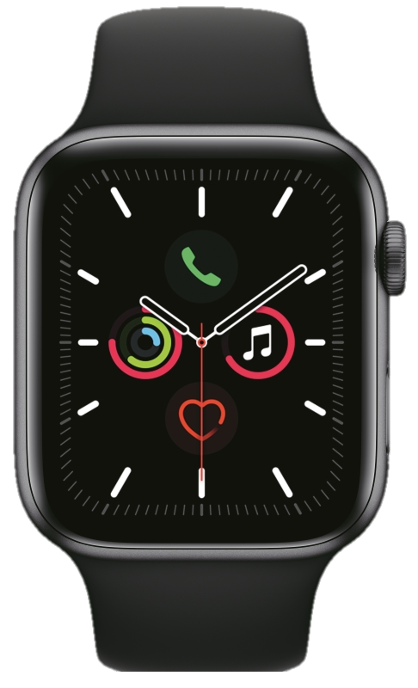

SLIDE HEADLINE
Header
The program can be fleshed out by the plan
Header
The program can be fleshed out by the plan
The researcher needs to observe certain logic and steps when organizing the experiment. Basically, they allocate 4 to 6 stages, which reflect the logic of the experimental study.
Header
The program can be fleshed out by the plan

Slide 19


SLIDE HEADLINE
The researcher needs to observe certain logic and steps when organizing the experiment. Basically, they allocate 4 to 6 stages, which reflect the logic of the experimental study.
The researcher needs to observe certain logic and steps when organizing the experiment. Basically, they allocate 4 to 6 stages, which reflect the logic of the experimental study.

Slide 20

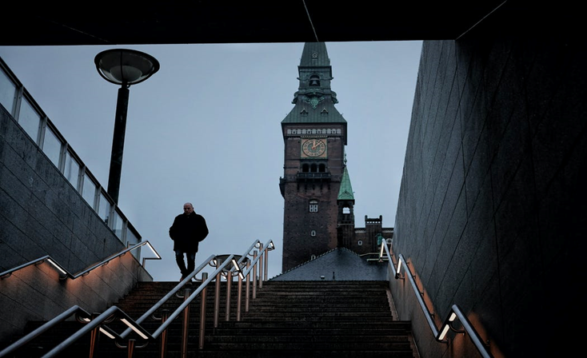
SLIDE HEADLINE
The researcher needs to observe certain logic and steps when organizing the experiment. Basically, they allocate 4 to 6 stages, which reflect the logic of the experimental study.
The researcher needs to observe certain logic and steps when organizing the experiment. Basically, they allocate 4 to 6 stages, which reflect the logic of the experimental study.

Slide 21

SLIDE HEADLINE
The researcher needs to observe certain logic and steps when organizing the experiment. Basically, they allocate 4 to 6 stages, which reflect the logic of the experimental study.
The researcher needs to observe certain logic and steps when organizing the experiment. Basically, they allocate 4 to 6 stages, which reflect the logic of the experimental study.

Slide 22
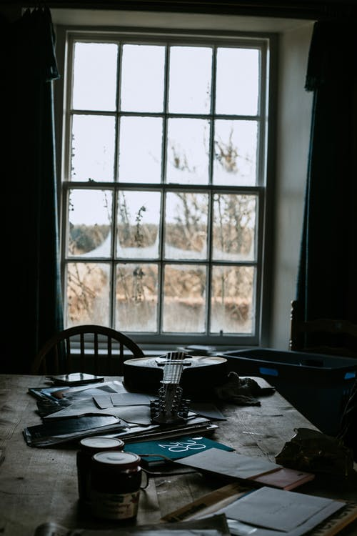
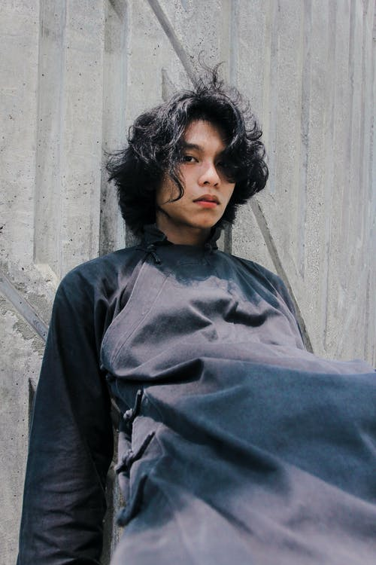
SLIDE HEADLINE
The researcher needs to observe certain logic and steps when organizing the experiment. Basically, they allocate 4 to 6 stages, which reflect the logic of the experimental study.

Slide 23
SLIDE HEADLINE
The researcher needs to observe certain logic and steps when organizing the experiment. Basically, they allocate 4 to 6 stages, which reflect the logic of the experimental study.
The researcher needs to observe certain logic and steps when organizing the experiment. Basically, they allocate 4 to 6 stages, which reflect the logic of the experimental study.
The researcher needs to observe certain logic and steps when organizing the experiment. Basically, they allocate 4 to 6 stages, which reflect the logic of the experimental study.
SUBTITLE

Slide 24

SLIDE HEADLINE
The researcher needs to observe certain logic and steps when organizing the experiment. Basically, they allocate 4 to 6 stages, which reflect the logic of the experimental study.
The researcher needs to observe certain logic and steps when organizing the experiment. Basically, they allocate 4 to 6 stages, which reflect the logic of the experimental study. The researcher needs to observe certain logic and steps when organizing the experiment. Basically, they allocate 4 to 6 stages, which reflect the logic of the experimental study. The researcher needs to observe certain logic and steps when organizing the experiment. Basically, they allocate 4 to 6 stages, which reflect the logic of the experimental study.

Slide 25

SLIDE HEADLINE
Use this device to create promising paintings already in the Middle Ages, and among artists of the Renaissance

Slide 26

SLIDE HEADLINE
Use this device to create promising paintings already in the Middle Ages, and among artists of the Renaissance

Slide 27

SLIDE HEADLINE
Use this device to create promising paintings already in the Middle Ages, and among artists of the Renaissance

Slide 28

SLIDE HEADLINE
Use this device to create promising paintings already in the Middle Ages, and among artists of the Renaissance

Slide 29

Use this device to create promising paintings already in the Middle Ages, and among artists of the Renaissance
1
Use this device to create promising paintings already in the Middle Ages, and among artists of the Renaissance
2
SLIDE HEADLINE
Use this device to create promising paintings already in the Middle Ages, and among artists of the Renaissance
3

Slide 30

Use this device
01
Use this device
02
Use this device
03
Use this device
04

Slide 31






SLIDE HEADLINE
permissions to conduct the experiment
permissions to conduct the experiment
permissions to conduct the experiment
permissions to conduct the experiment
permissions to conduct the experiment
permissions to conduct the experiment

Slide 32
SLIDE HEADLINE
permissions to conduct the experiment
permissions to conduct the experiment
permissions to conduct the experiment
permissions to conduct the experiment

Slide 33
SLIDE HEADLINE
Strengths
Use this device to create promising paintings already in the Middle Ages, and among artists of the Renaissance
Weaknesses
Use this device to create promising paintings already in the Middle Ages, and among artists of the Renaissance
S
W
O
T
Opportunities
Use this device to create promising paintings already in the Middle Ages, and among artists of the Renaissance
Threats
Use this device to create promising paintings already in the Middle Ages, and among artists of the Renaissance

Slide 34
THESIS
THESIS
THESIS
THESIS
START
THESIS
THESIS
THESIS
THESIS
THESIS

Slide 35



SLIDE HEADLINE
SUB-LOGS
SUB-LOGS
SUB-LOGS
Use this device to create promising paintings already in the Middle Ages, and among artists of the Renaissance
Use this device to create promising paintings already in the Middle Ages, and among artists of the Renaissance
Use this device to create promising paintings already in the Middle Ages, and among artists of the Renaissance

Slide 36




SLIDE HEADLINE
Use this device to create promising paintings already in the Middle Ages, and among artists of the Renaissance. Use this device to create promising paintings already in the Middle Ages, and among artists of the Renaissance. Use this device to create promising paintings already in the Middle Ages, and among artists of the Renaissance
Ksenia
Use this device to create promising paintings already in the Middle Ages, and among artists of the Renaissance
SUB-LOGS
SUB-LOGS
SUB-LOGS
Use this device to create
Use this device to create
Use this device to create

Slide 37
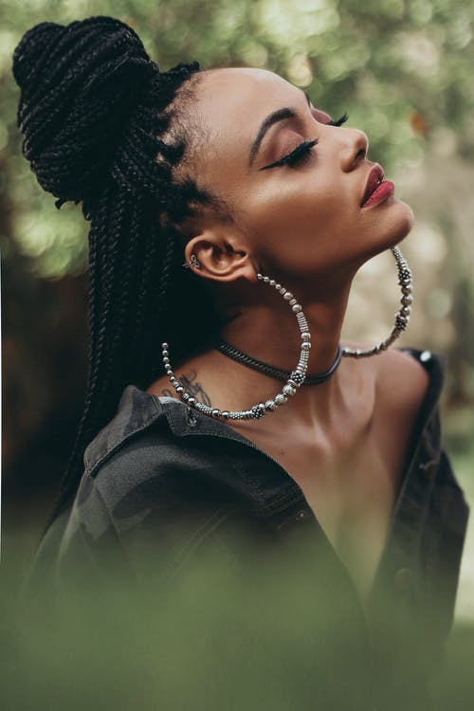

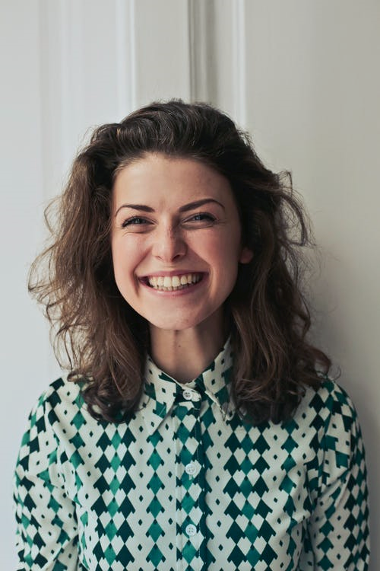

SLIDE HEADLINE
Use this device to create promising paintings already in the Middle Ages, and among artists of the Renaissance. Use this device to create promising paintings already in the Middle Ages, and among artists of the Renaissance
NAME
NAME
NAME
NAME

Slide 38


VICTORIA
KSENIA
Targetologist
Designer
Use this device
Использовать это приспособление
Use this device to create promising paintings already in the Middle Ages, and among artists of the Renaissance
Use this device to create promising paintings already in the Middle Ages, and among artists of the Renaissance

Slide 39
Calendar 2021
January
February
March
S | M | T | W | T | F | S
 |  |  |  |  | 1 | 2
3 | 4 | 5 | 6 | 7 | 8 | 9
10 | 11 | 12 | 13 | 14 | 15 | 16
17 | 18 | 19 | 20 | 21 | 22 | 23
24 | 25 | 26 | 27 | 28 | 29 | 30
31
S | M | T | W | T | F | S
 | 1 | 2 | 3 | 4 | 5 | 6
7 | 8 | 9 | 10 | 11 | 12 | 13
14 | 15 | 16 | 17 | 18 | 19 | 20
21 | 22 | 23 | 24 | 25 | 26 | 27
28
S | M | T | W | T | F | S
 | 1 | 2 | 3 | 4 | 5 | 6
7 | 8 | 9 | 10 | 11 | 12 | 13
14 | 15 | 16 | 17 | 18 | 19 | 20
21 | 22 | 23 | 24 | 25 | 26 | 27
28 | 29 | 30 | 31

Slide 40
Calendar 2021
April
May
June
S | M | T | W | T | F | S
 |  |  |  | 1 | 2 | 3
4 | 5 | 6 | 7 | 8 | 9 | 10
11 | 12 | 13 | 14 | 15 | 16 | 17
18 | 19 | 20 | 21 | 22 | 23 | 24
25 | 26 | 27 | 28 | 29 | 30
S | M | T | W | T | F | S
 |  |  |  |  |  | 1
2 | 3 | 4 | 5 | 6 | 7 | 8
9 | 10 | 11 | 12 | 13 | 14 | 15
16 | 17 | 18 | 19 | 20 | 21 | 22
23 | 24 | 25 | 26 | 27 | 28 | 29
30 | 31
S | M | T | W | T | F | S
 |  | 1 | 2 | 3 | 4 | 5
6 | 7 | 8 | 9 | 10 | 11 | 12
13 | 14 | 15 | 16 | 17 | 18 | 19
20 | 21 | 22 | 23 | 24 | 25 | 26
27 | 28 | 29 | 30

Slide 41
Calendar 2021
July
August
September
S | M | T | W | T | F | S
 |  |  |  | 1 | 2 | 3
4 | 5 | 6 | 7 | 8 | 9 | 10
11 | 12 | 13 | 14 | 15 | 16 | 17
18 | 19 | 20 | 21 | 22 | 23 | 24
25 | 26 | 27 | 28 | 29 | 30 | 31
S | M | T | W | T | F | S
1 | 2 | 3 | 4 | 5 | 6 | 7
8 | 9 | 10 | 11 | 12 | 13 | 14
15 | 16 | 17 | 18 | 19 | 20 | 21
22 | 23 | 24 | 25 | 26 | 27 | 28
29 | 30 | 31
S | M | T | W | T | F | S
 |  |  | 1 | 2 | 3 | 4
5 | 6 | 7 | 8 | 9 | 10 | 11
12 | 13 | 14 | 15 | 16 | 17 | 18
19 | 20 | 21 | 22 | 23 | 24 | 25
26 | 27 | 28 | 29 | 30

Slide 42
Calendar 2021
October
November
December
S | M | T | W | T | F | S
 |  |  |  |  | 1 | 2
3 | 4 | 5 | 6 | 7 | 8 | 9
10 | 11 | 12 | 13 | 14 | 15 | 16
17 | 18 | 19 | 20 | 21 | 22 | 23
24 | 25 | 26 | 27 | 28 | 29 | 30
31
S | M | T | W | T | F | S
 | 1 | 2 | 3 | 4 | 5 | 6
7 | 8 | 9 | 10 | 11 | 12 | 13
14 | 15 | 10 | 17 | 18 | 19 | 20
21 | 22 | 23 | 24 | 25 | 26 | 27
28 | 29 | 30
S | M | T | W | T | F | S
 |  |  | 1 | 2 | 3 | 4
5 | 6 | 7 | 8 | 9 | 10 | 11
12 | 13 | 14 | 15 | 16 | 17 | 18
19 | 20 | 21 | 22 | 23 | 24 | 25
26 | 27 | 28 | 29 | 30 | 31

Slide 43

SLIDE HEADLINE

Slide 44
SLIDE HEADLINE
SUBTITLE 25%
Use this device to create promising paintings already in the Middle Ages, and among artists of the Renaissance
SUBTITLE 30%
Use this device to create promising paintings already in the Middle Ages, and among artists of the Renaissance
SUBTITLE 45%
Use this device to create promising paintings already in the Middle Ages, and among artists of the Renaissance

Slide 45


SLIDE HEADLINE
Use this device to create promising paintings already in the Middle Ages, and among artists of the Renaissance
Use this device to create promising
Use this device to create promising

Slide 46

SLIDE HEADLINE
Use this device to create promising paintings already in the Middle Ages, and among artists of the Renaissance Use this device to create promising paintings already in the Middle Ages, and among artists of the Renaissance

Slide 47
SLIDE HEADLINE
A
Use this device to create promising paintings already in the Middle Ages, and among artists of the Renaissance
B
Use this device to create promising paintings already in the Middle Ages, and among artists of the Renaissance
C
Use this device to create promising paintings already in the Middle Ages, and among artists of the Renaissance

Slide 48
HEADLINE
Use this device to create promising paintings already in the Middle Ages, and among artists of the Renaissance. Use this device to create promising paintings already in the Middle Ages, and among artists of the Renaissance
Use this device to create promising paintings already in the Middle Ages, and among artists of the Renaissance

Slide 49
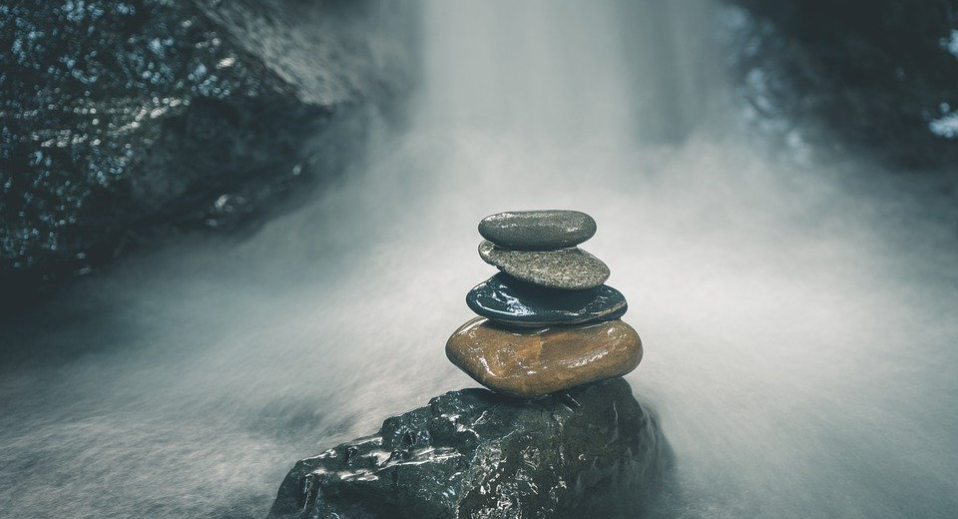
THANKS
+77476991263

Slide 50
THANK YOU FOR YOUR ATTENTION

